Slide 1


COP 5614 Operating System
TC Control of Docker Containers
By Aldawsari Mohammed, Nishant Maurya, Yezehao Huai, Shuai Xue

Slide 2
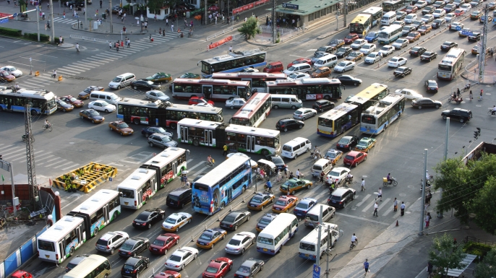
Introduction
Part I Introduction & Related work
Part II Motivation & Methodology
Part III Experimental Setup & Result
Part IV Demo

Slide 3

Competing
CPU
Memory
Disk I/O
Network bandwidth

Slide 4
Related Work
A suite of workloads that stress the CPU, memory, storage and networking resources. They show that containers result in equal or better performance than VM in almost all cases. Felter et al.[1]
A limited Docker’s bandwidth to guarantee the quality of service on the network. Ensuring that critical and time-sensitive applications hosted in high-priority containers can receive a better share of a network bandwidth, without starving other containers. Dusia and Yang[2]
Apache Spark using Docker can obtain speeds up to over 10 times when compared to VM. Bhimani et al.[3]

Slide 5
Motivation
Challenge
Optimal resource utilization and reduce competition
Idea
Evaluate the performance of Hadoop and Spark based on Docker containers under different bandwidths.
Report the performance loss and gain of big data applications based on the bandwidth size as well as the individual container’s behavior.
Part I Introduction & Related work
Part II Motivation & Methodology
Part III Experimental Setup & Result
Part IV Demo

Slide 6
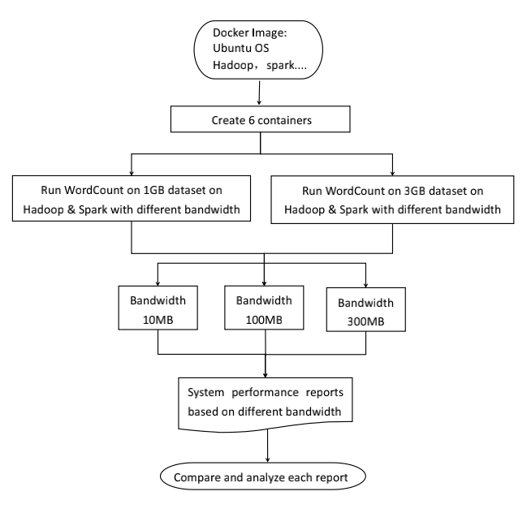




Methodology
Implementation Tools

Slide 7
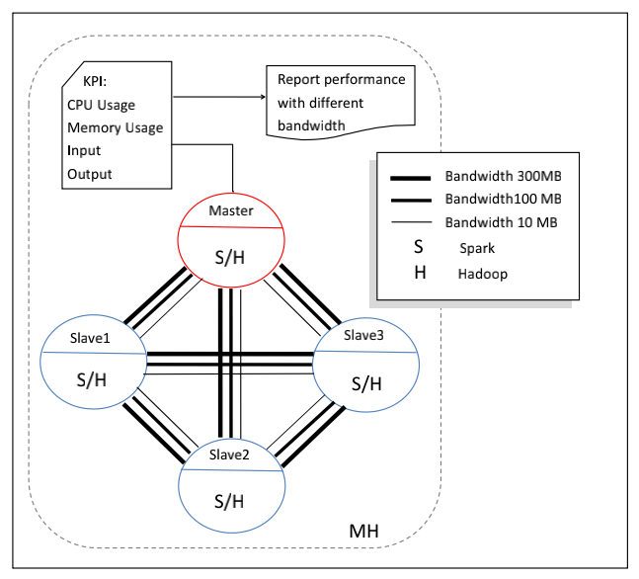
Bandwidth Change Framework

Slide 8
Experiment Setup
① Hardware:
2.7GHz Core i5 processor and 16GB RAM.
using Ubuntu Docker image 14.04 and Hadoop 2.7.2, Spark 1.2.0, openssh-server, wget, openjdk-7 and nano editor.
②PUMA benchmarks and dataset, wherein we downloaded Wikipedia dataset of size 50GB and then truncate it to two gigabytes for our experiment.
③Docker network to allow containers join the cluster using the network name and can be identified by name in the cluster.
Part I Introduction & Related work
Part II Motivation & Methodology
Part III Experimental Setup & Result
Part IV Demo

Slide 9
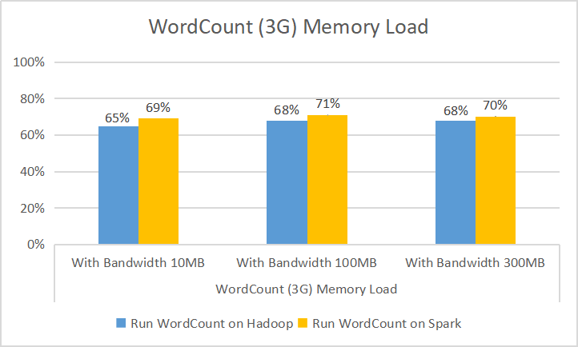
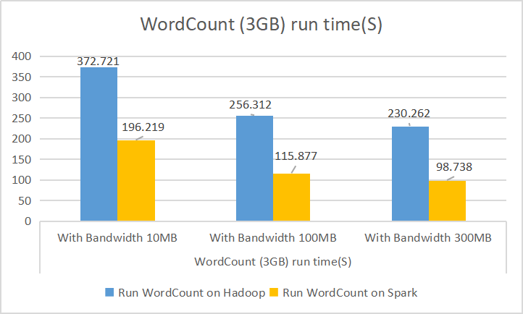
Experimental Result
Figure 4: Word Count (3G) run time(s)

Slide 10
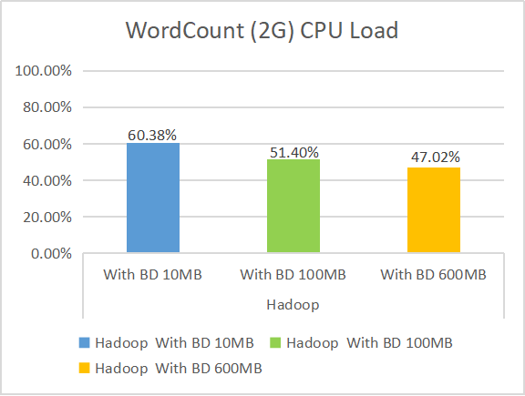
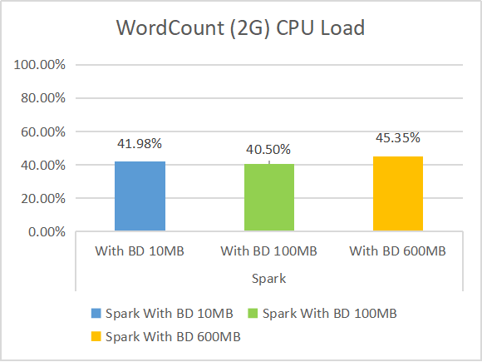
Experimental Result
Figure 5: Word Count (2G) CPU Load

Slide 11
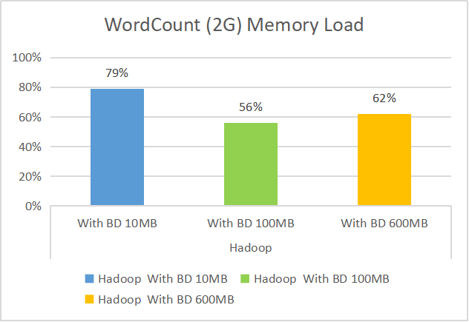
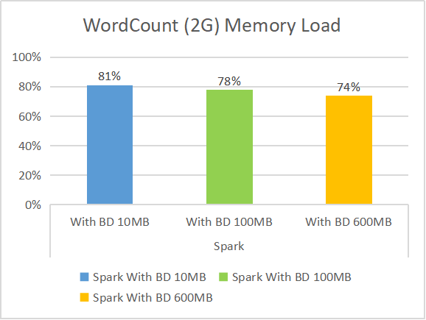
Experimental Result
Figure 6: Word Count (2G) Memory Load

Slide 12
Part I Introduction & Related work
Part II Motivation & Methodology
Part III Experimental Setup & Result
Part IV Demo
Demo

Slide 13
Thank you
For more PPT templates，visit : www.tretars.com

